Slide 2
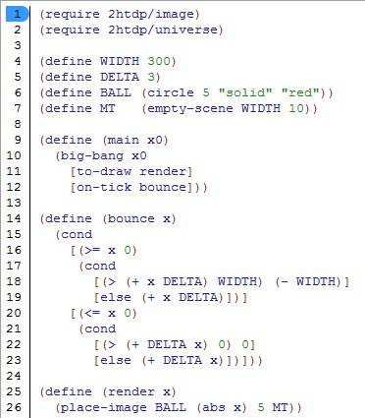
Warm Up - bounce
In your notebooks, describe what the program will do?

Slide 3
Objectives
Knowledge:
How do we iteratively develop complex programs?
Skills:
Follow a design process to create a program to land a UFO.

Slide 4
Warm Up - Evaluate each expression
(sign 10)
(sign -5)
(sign 0)
(define (sign x)
(cond
[(> x 0) 1]
[(= x 0) 0]
[(< x 0) -1]))

Slide 5
big-bang project
Design a program that simulates the descent of a UFO.
or any object of your choice. The object must start at the top of the screen and land on its feet.

